Slide 1


Lesson 3: How HTTPS & Encryption Work
Understanding Web Security Basics

Slide 2
Why Online Security Matters
Imagine sending a postcard (HTTP) vs. a locked briefcase (HTTPS).
This lesson helps you understand how to stay safe online.
Goals: Learn about HTTPS, encryption, and Wi-Fi security.

Slide 3
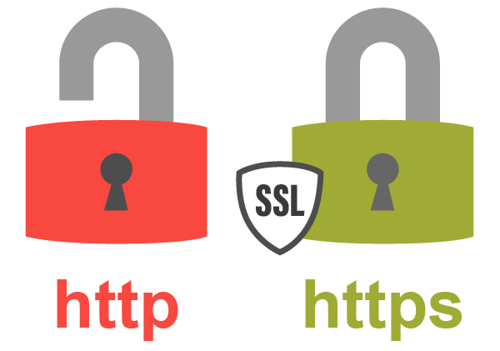
HTTP vs. HTTPS: Understanding the Secure Padlock
HTTP
HTTPS
Padlock Icon
Standard web protocol, data sent unencrypted in plain text and vulnerable to intercept.
Secure protocol using encryption to protect data
Shows the site is secure and data is encrypted
Look for the padlock icon in your browser (🔒).

Slide 4
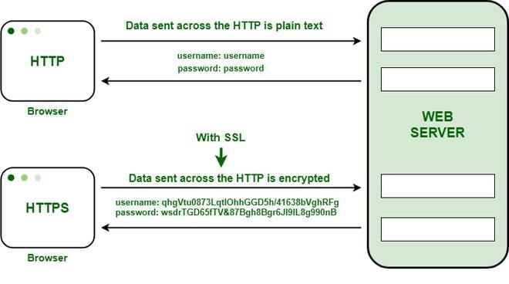
Why HTTPS Matters
without https, hackers can see your passwords and messages.
https ensures data is encrypted and the site is authentic.

Slide 5
What is Encryption?
Encryption scrambles your data into unreadable form.
Only the intended receiver can decrypt it using a key.
Used in web browsing, messaging, and online payments.

Slide 6

The Role of Encryption in Online Safety
Data Privacy
Encryption hides data from unauthorized viewers
Data Integrity
Protects data from being altered or tampered with
Trust Building
Ensures you connect to authentic websites securely

Slide 7
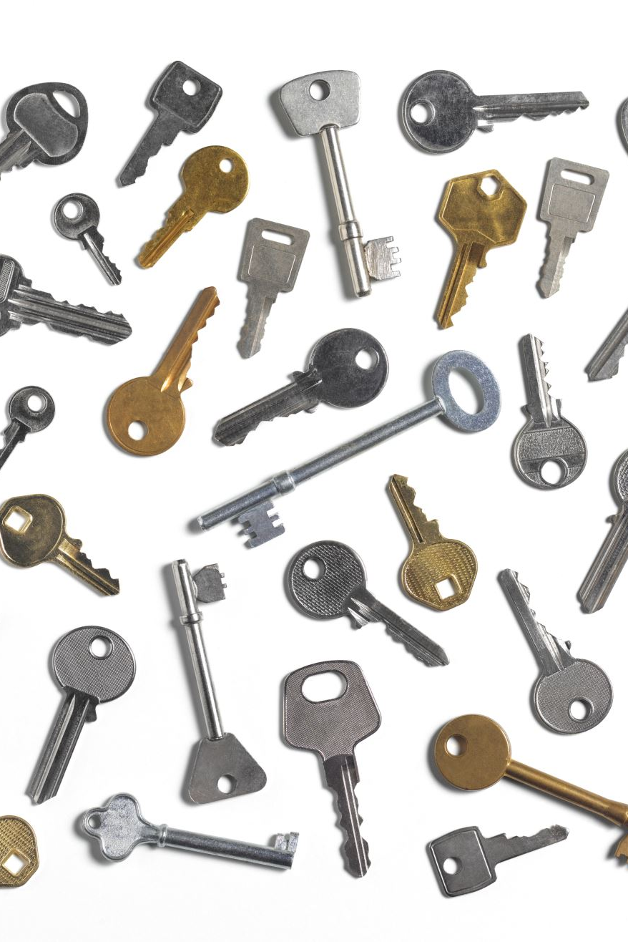
Public-Key Encryption (Analogy)
Public key = an open treasure chest anyone can put messages into.
Private key = only you have the key to open it.
Used in HTTPS to protect data without sharing passwords.

Slide 8
Encrypted Email Example
ProtonMail and Tutanota use end-to-end encryption.
Even the email service can't read your messages.
Try it: Create an account on https://proton.me

Slide 9
Risks of Public Wi-Fi
Public Wi-Fi is often unencrypted.
Others on the same network can intercept your data.
Use a VPN to encrypt your connection over public networks.

Slide 10
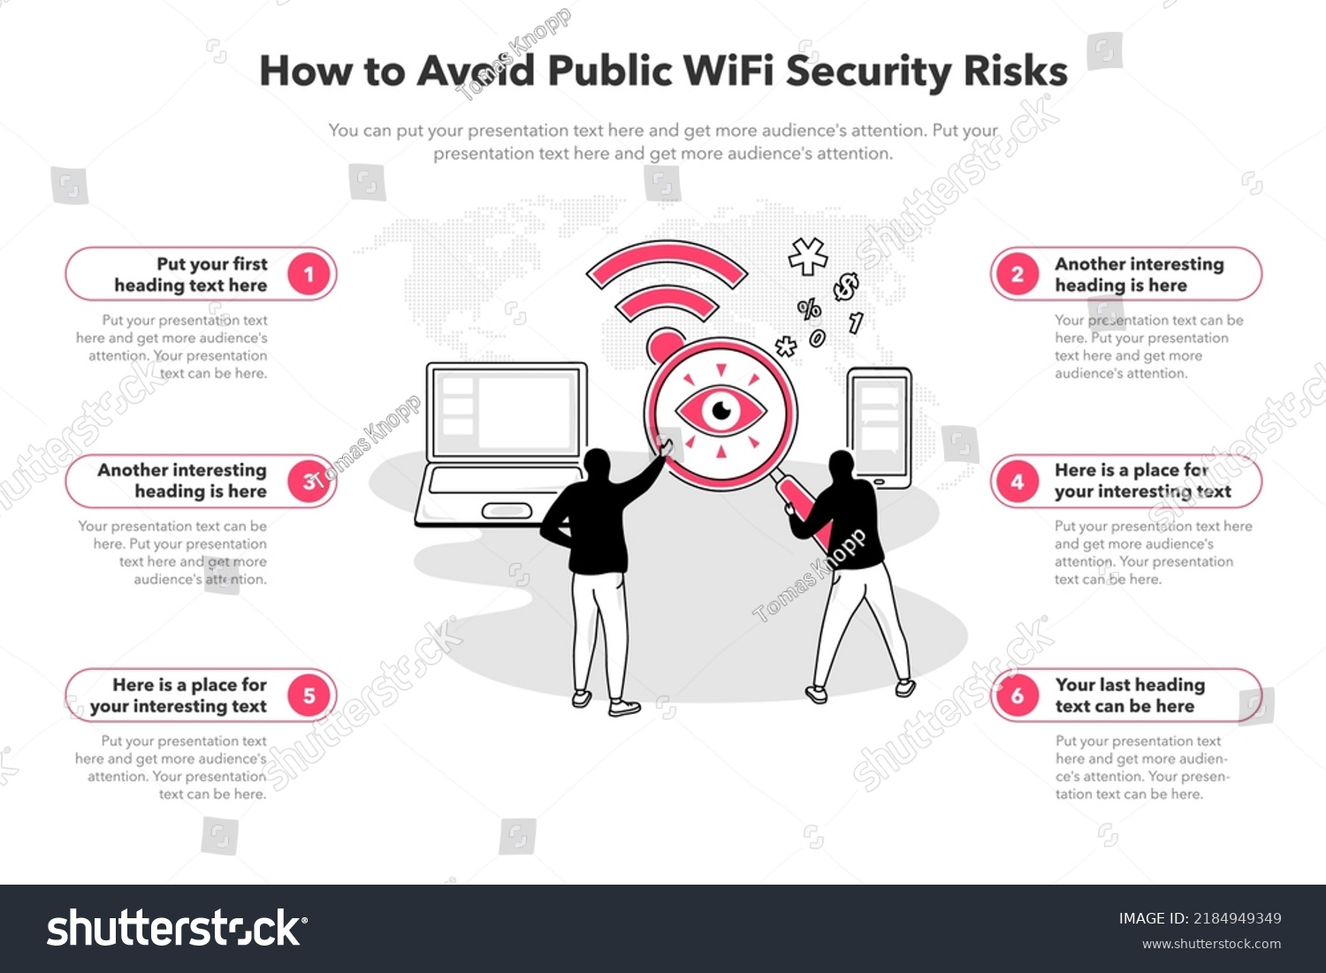
Risks of Public Wi-Fi
Public Wi-Fi is often unencrypted.
Others on the same network can intercept your data.
Use a VPN to encrypt your connection over public networks.

Slide 11
Hands-On: CyberChef Caesar Cipher
Visit: https://gchq.github.io/CyberChef/
Search 'Caesar Cipher', enter 'HELLO', shift by 3.
Output: 'KHOOR' – Try decrypting your partner's message.

Slide 12
HTTPS Scavenger Hunt
Visit 5 websites and check for HTTPS (🔒).
Note which are secure or insecure.
Try: https://badssl.com for safe SSL testing examples.

Slide 13
Quiz & Summary
Quiz: Test your knowledge (via Google Form) – Navigate to quizzes folder
Summary: HTTPS secures your data, encryption hides it, VPN protects you on public Wi-Fi.
You're now equipped with web security basics!

